Slide 1
Experimental Economics Lecture 4
Fourth presentation to the Doctoral Students, University of Bari
John Hey
October 2023

Slide 2
Software
Software for implementing the experiment.
Testing the software.
Running the experiment.
In the laboratory or online.
…but first, some information and some informative sites.
… and, at the end, the task for today.

Slide 3
Real versus hypothetical payments
I have done some searching and there seem to be two general results which shed light on this.
It depends upon the context. For some contexts, results with hypothetical payments are close to those with real payoffs; in other contexts, the results are quite different.
The magnitude of the payments seems to affect the spread but not the mean of the distribution of answers/decisions; with greater payments implying less spread but much the same mean …
… UNLESS the answers/decisions are at a bound, so that with a lower bound) the mean is lower with higher payments (and the spread less), and with an upper bound) the mean is higher with higher payments (and the spread less).

Slide 4
Paying on all problems or on just one Paying all subjects or just a subset
There is a very good article on this by Charness et al. I have put it on the site.
They state in the abstract “While the evidence on differences across payment methods is mixed, overall it suggests that paying for only a subset of periods or individuals is at least as effective as the “pay all” approach and can well be more effective.”
You should read the paper to get insight.

Slide 5
Interesting and informative sites
Ariel Rubinstein has a beautiful site full of useful information.
Ariel Rubinstein’s Web-Based Experiments in GAME THEORY.
Handbook of Experimental Economics is an early survey
Handbook of Experimental Economics volume 2 is an updated survey.
Handbook of Experimental Economics Results contains results.
Classroom Experiments in Economics is a useful guide to experiments you can run in the classroom.
Charlie Holt’s Veconlab contains many experiments that you can try.

Slide 6
Let’s play this simple game (if you have not played it before)
The Guessing Game
Each of you individually are asked to pick a number between 0 and 100, with the winner of the contest being the student that is closest to 2/3 times the average number picked of all students.
An alternative
Each of you individually are asked to pick a number between 0 and 100, with the winner of the contest being the student that is closest to 4/3 times the average number picked of all students.

Slide 7
Monty Halls’ three doors problem
There are 3 doors, behind which are two goats and a car.
You pick a door (call it door A). You’re hoping for the car of course.
Monty Hall, the game show host, examines the other doors (B & C) and opens one with a goat. (If both doors have goats, he picks randomly.)
Here’s the game: Do you stick with door A (original guess) or switch to the unopened door? Does it matter?
Let us play it.
Later we will look at Prof Morone’s refinement of the problem.

Slide 8
Prof Morone’s refinement
You pick two doors but do not open them.
Monty Hall opens one of the two doors you have chosen and shows that there is a goat behind it.
Should you switch to the remaining door?

Slide 9
Experimental software
This depends upon the type of experiment and your programming skills.
You could, of course, do one without software, but software provides a structure, and a way of collecting data.

Slide 10
Possible softwares
There is always a trade-off – here between the flexibility of the software and the difficulty of writing with it.
The more flexible, the more difficult to program.
The list is long, but here is a short list, starting with the easiest to write:
Z-tree, O-tree (with their online versions Z-tree unleashed) – relatively easy, lots of ready-written code, but terrible colours.
Visual Studio (Basic, C++) – very flexible but slow to write.
Python – very difficult, but very flexible.

Slide 11
What the software should do
It should be visually appealing and clear.
It should be clear what subjects should do at every stage.
Finally, and very importantly, it should record EVERYTHING that happened – everything displayed on the screen, and every keystroke that the subject made.
This may make it a large file, but you might not know before the experiment what data may be useful for your data analysis later.

Slide 12
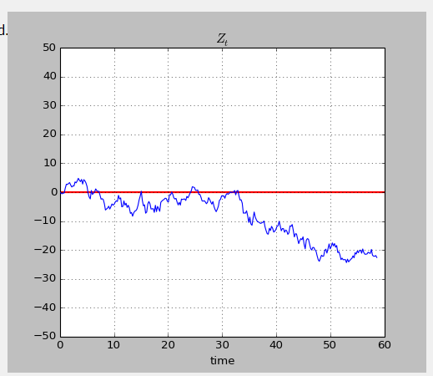
An example of a Python interface An experiment testing Epstein and Ji The subjects saw an evolving graph giving (costly) information, and the theory was about seeing when they stopped gathering information. The software did not record every position of the graph – which we realised later would have been useful for data analysis.
This was programmed in Python

Slide 13
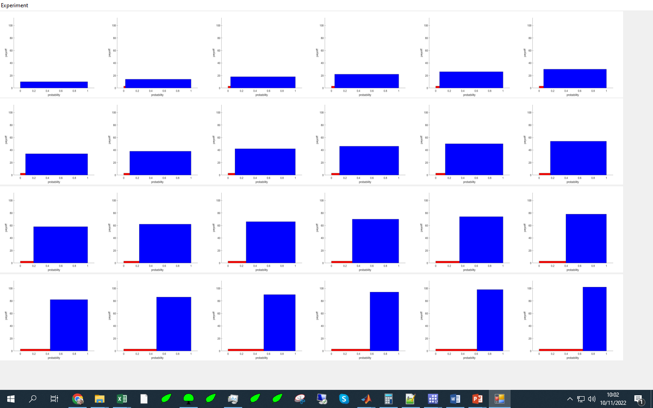
An example of a Visual Studio interface

Slide 14
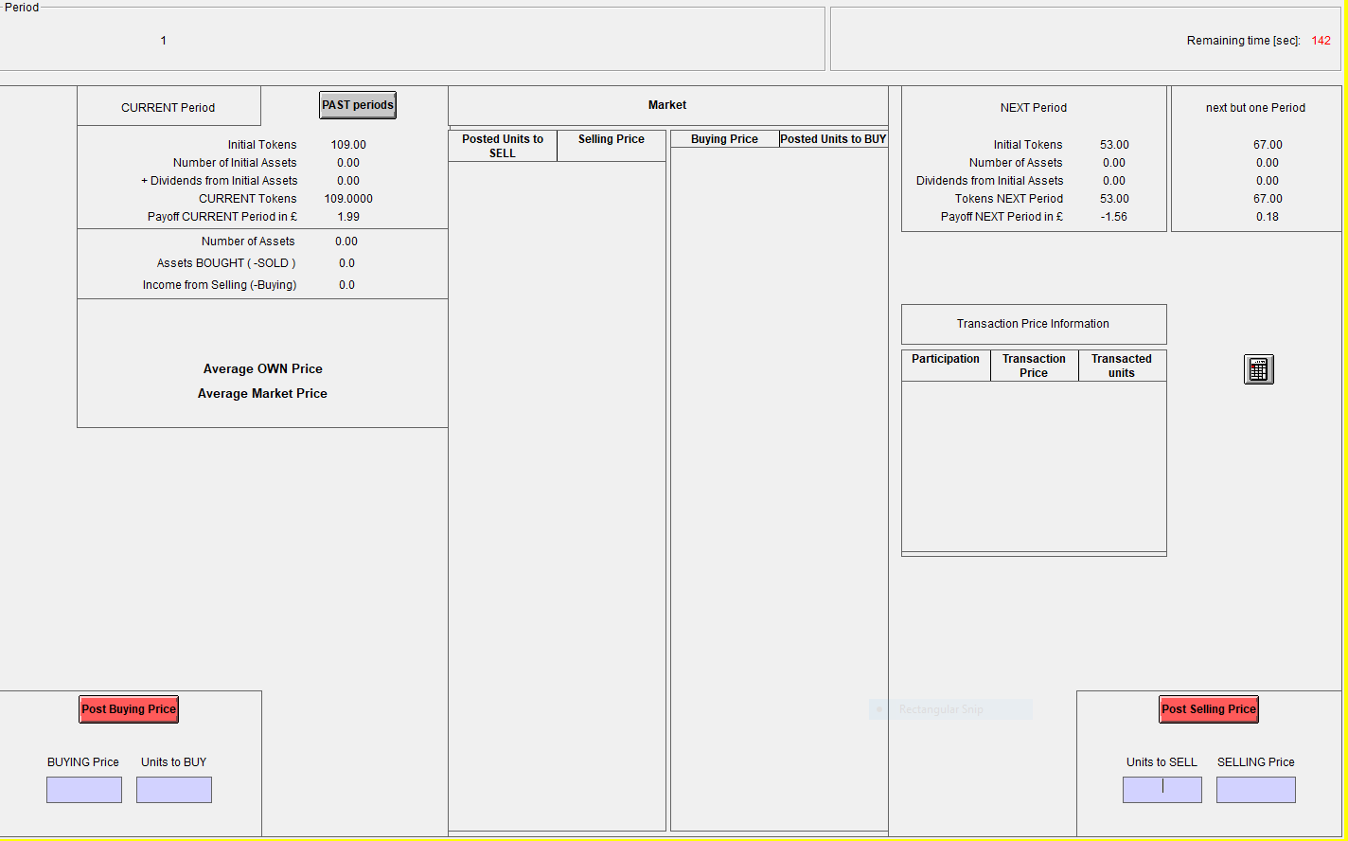
An example of a Z-tree interface An experiment published in Management Science.
This was programmed wih Z-tree

Slide 15
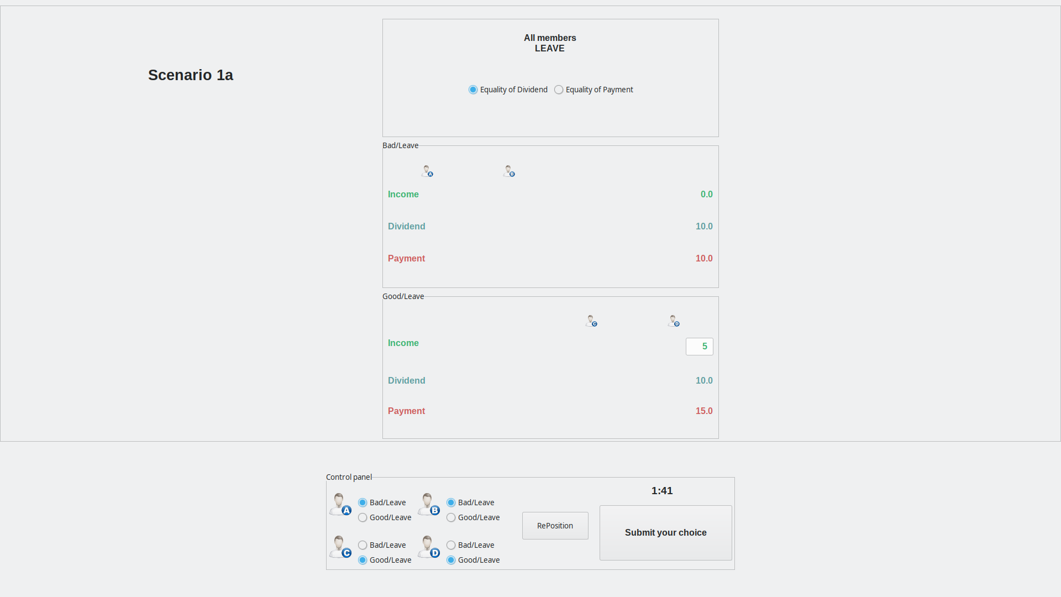
Another example of a Python interface An experiment by Bone, Crosetto, Hey and Pasca
This was programmed in Python

Slide 16
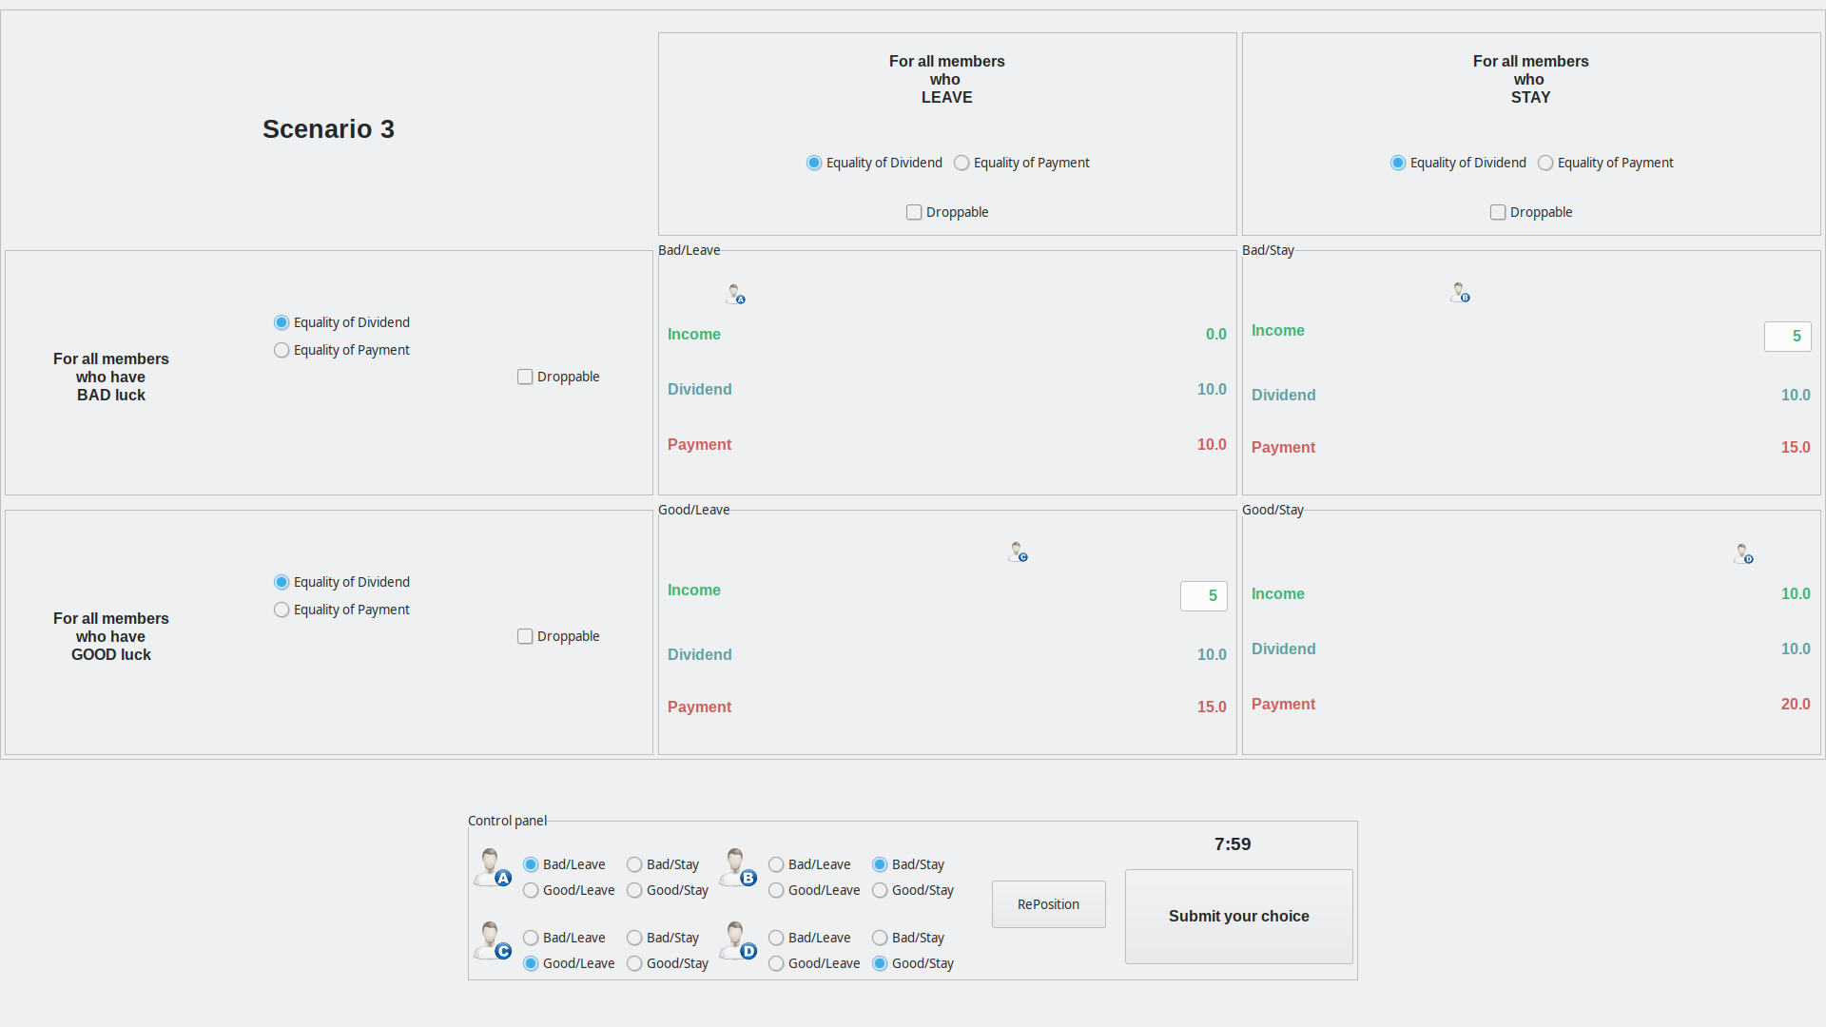
Another example of a Python interface An experiment by Bone, Crosetto, Hey and Pasca
This was
programmed
in Python

Slide 17
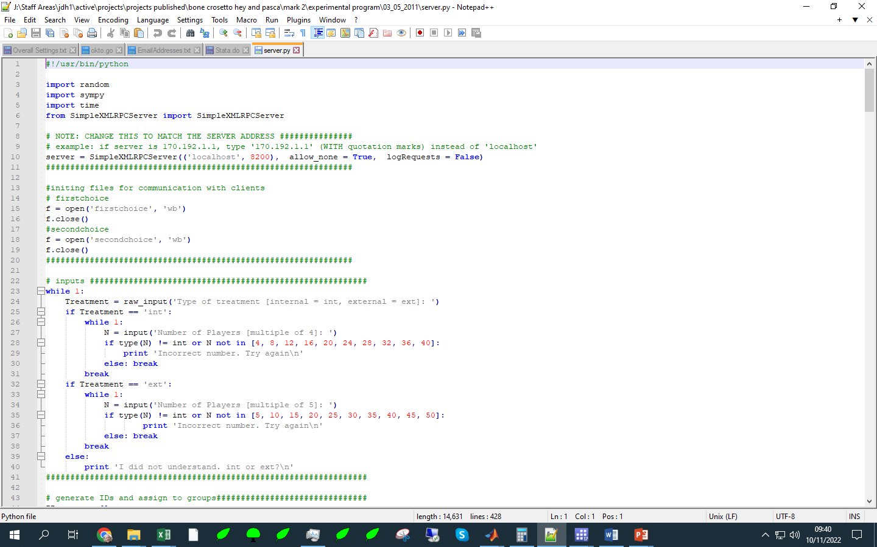
Part of a Python program

Slide 18
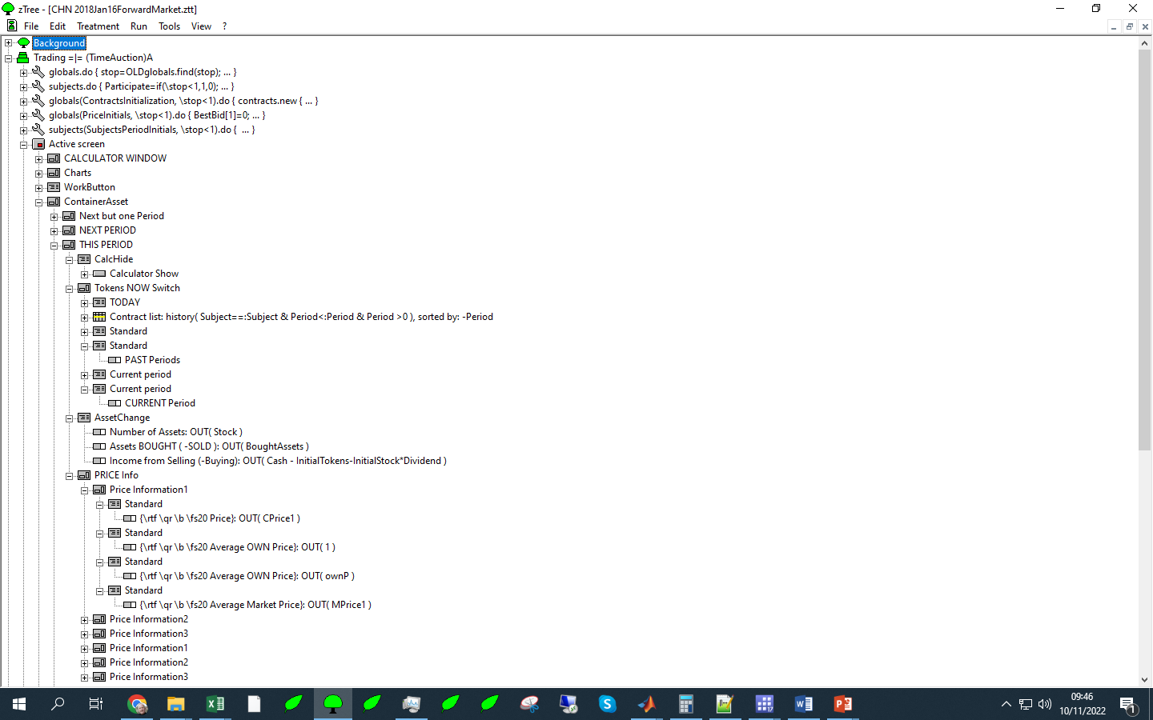
Part of a Z-tree program

Slide 19
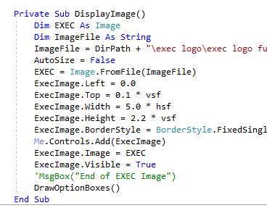
Part of a Visual Studio Program 2 Programming involves a set of functions. This is a second – to move the subject on.

Slide 20
Part of a Visual Studio Program 1 Programming involves a set of functions. This is one – to display the EXEC logo.

Slide 21
How to write your software Advice independent of the choice of software
Write in blocks and use functions
Every function executes a part of the experiment (for example, reading input data, processing the data if necessary, writing the Instructions, setting some test questions for understanding, drawing the decision screen, recording the subject’s responses, writing the output data to a file.)
Split your program into blocks.
Try and make the screen visually appealing.
Moreover, make it clear what the subject should do at every stage…
… and whether they need to type some input or click on some box.

Slide 22
If you are going to get someone else to write the experimental software
Choose the person carefully, brief them well, and make sure that you have all rights over the software when it is finished.

Slide 23
Running the Experiment in the laboratory
The recruitment of subjects, and booking them into slots.
Greeting the subjects and initiating the experiment.
Checking that the subjects understand the Instructions.
Running the experiment.
A post-experimental questionnaire.
Paying the subjects.

Slide 24
Running the Experiment in the laboratory: The recruitment of subjects, and booking them into slots.
There are several recruitment softwares, the most used are Orsee and Hroot.
With both of these, the software maintains a Register of potential subjects, with some demographic data (depending on how you configure it).
You have to set up the Register and send out invitations (perhaps using the University’s email system) for people to join the Register.
If you are working somewhere which already has a Register, you can use it.
You can initiate a new experiment, send out invitations and (self-) organise them into slots.
When the experimental session is finished you can save data on who participated and how much they were paid.

Slide 25
Running the Experiment in the laboratory Greeting the subjects and initiating the experiment
There should be somewhere in the lab where they can wait.
We ask them to take a numbered token from an ordered set.
Keep a record of who showed up (this will be inputted into hroot later).
Take them into the lab and seat them appropriately (if the experiment requires this) or seat them according to the number that they took on arrival.
Leave printed Instructions, some blank sheets of paper and a pen on their desk.
When all settled, read out the Instructions over the tannoy system.
Show the Panopto recording of the Instructions, if you have prepared one.
Ask them if they have any questions.
Start the experiment (at the beginning you may have some questions checking whether they understand the Instructions).
During the experiment, make sure that they are not communicating with each other or surfing the Internet – your IT person can stop this).

Slide 26
Running the Experiment in the laboratory Making sure that the subjects understand the Instructions.
I would recommend that, before they start the experiment, you ask some questions which they have to answer before proceeding to the experiment.
These should test whether they understand what they are being asked to do, not how to do it.

Slide 27
Running the Experiment in the laboratory A post-experimental questionnaire
Some experimental economists routinely do this.
Z-tree has a questionnaire at the end.
The questionnaire could be small or large.
You should tell them at the start that there will be such a questionnaire.
Should you have one?
To me it seems odd to have a (necessarily unincentivised) questionnaire when all experimental economists believe in incentives.
But many are doing this (gives them some more data).

Slide 28
Running the Experiment in the laboratory Paying the subjects
The easiest way by far is paying them in cash.
They should sign a receipt (your funders will need to see these).
Other ways are explained in the ‘online’ section.
The payment should include a participation fee, if one was announced in the recruitment for the experiment.

Slide 29
Running the experiment online
There are several extra things you need to take into account which differ from when you are running the experiment in the lab.
Recruiting the subjects.
Running the experiment.
Making sure that the subjects understand the Instructions.
Monitoring the subjects during the experiment.
Paying the subjects.

Slide 30
Running the experiment online
Much depends upon what your IT people allow.
At York, security is very tight.
If your security people allow it, you could use Z-tree unleashed or O-tree.
These essentially allow anybody to log in to your experiment and hence creates security issues.
At York, the IT people are giving us a Virtual Machine, and only York users can log in to it. It will be as if the subjects were in the lab.

Slide 31
Running the experiment online with Z-tree unleashed and/or o-tree
The servers would be being operated by people without any IT security experience and they would, by the nature, have to be open to the world.

Slide 32
Running the experiment online with a Virtual Server
This is almost the same as running the experiment in the lab.
At York, this is restricted to subjects who have a York account.
You have a server and you can launch Z-tree or your purpose-built software from it.
You have a server and you can launch the subjects screens from it. Subjects can see it if they are logged in to the server.
You can give the subjects rights to login to the server. You can do this as you will know the subjects’ e-mail addresses from Hroot or Orsee.

Slide 33
Running the experiment online recruiting the subjects
In order to keep control, I would recommend recruiting them in the usual way – sending out invitations via hroot or orsee.
The invitations should give all information about how and when subjects log in to the experiment.
Depending upon how you plan to pay them, you should ask for information about their bank accounts (the account number and sort code).
You should also give them a Zoom link (for checking – see the next slide)

Slide 34
Running the experiment online Making sure that the subjects understand the Instructions.
I suggest you do this in the usual way, but giving them some question they need to answer correctly before they can proceed to the experiment.
You could also use the chat facility to communicate with any that are struggling.

Slide 35
Running the experiment online monitoring the subjects
You need to check that the subjects are the ones registered and that non-one is helping them.
I would recommend using Zoom or something similar, so that you can see them and they can talk to you and ask questions (if they wish)

Slide 36
Running the experiment online paying the subjects
This is perhaps the most difficult part.
If you are in China, there is an App that you can use.
You could use Paypal – but they take commission.
In Europe you can pay them via their bank account – if you have their details.

Slide 37
Now the task for today
I asked you to look at the paper by Epstein and Ji, a copy of which you can find on the course website.
This is a difficult paper to read and it is full of dense mathematics.
It is about decision-making under ambiguity.
It contains comparative static propositions [and also a precise optimal strategy for a DM with a particular preference functional (the maxmin model of ambiguity-averse preferences)].
Much of the paper is dense mathematics, but there are clear results:
[The solution for a maxmin DM is specified on the right-hand side of page 7 (equations 21 to 24)].
The comparative static propositions are
“Sampling time increases when (1) Cost c falls; (2) σ and α increase in such a way that α/σ² is constant”
(α is the drift in the Brownian Motion and σ is its dispersion; c is the cost of sampling)

Slide 38
A Task for today (continued)
I asked you to design a simple experiment which focusses on the Comparative Static propositions of the paper.
[Do not worry, at this stage about fitting the model and seeing if it fits better than other models.]
Describe the problem that subjects will be asked to tackle, and how they will be rewarded.
Pay particular attention to the number of treatments you will use, and the values of the key parameters* in the various treatments.
Describe how you would analyse the data.
*(α and σ, the drift and spread of the Brownian Motion; and c, the sampling cost.)

Slide 39
This is the end of Lecture 4.
As usual, I am happy to answer any questions.
You can email me at john.hey@york.ac.uk

